Slide 1
Nipiagogeio
Potamou Germasogeias 1
COGNITIVE LESSONS
School year 2020-2021

Slide 2
Ολόπλευρη ανάπτυξη
Γνωστικά αντικείμενα
Full development
Cognitive lessons
Μαθηματικά
Mathematics

Slide 3
The purpose of mathematics in kindergarten is to develop mathematical thinking and problem solving → support for general all-round development of the child.

Slide 4
Spatiotemporal concepts (up-down, inside/out, back/front, left/right)
Understanding concepts as a whole, more / less / equal Groupings
Altitude concept of numbers (numerical symbols distinction, cardinality, writing)
Correspondence patterns
Geometrical shapes
Construction and interpretation
of graphs

Slide 5
Ολόπλευρη ανάπτυξη
Γνωστικά αντικείμενα
Full development
Cognitive lessons
Γλωσσική αγωγή
LANGUAGE EDUCATION

Slide 6
The aim of language education is to provide appropriate experience within the interests and abilities of children to develop communication skills (verbal and otherwise), speech skills (oral and written) and foster positive attitudes to language contact and literature.

Slide 7

The development of language and the ability to communicate primarily enhanced from contacts with others.
Hearing-Listening
Oral expression (speech)
Emergent Literacy-Writing
Emergent Literacy-Read understanding

Slide 8
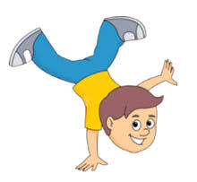
Language skills
Children should:
Take part in conversations as listener-speaker
Express feelings, opinions and decisions, to explain and argue about their choices
Enrich their vocabulary
Make right structured sentences
Tell a story by seeing the pictures
Recognize the "voices-sounds" of the letters
To describe objects and events

Slide 9


Ολόπλευρη ανάπτυξη
Γνωστικά αντικείμενα
Full development
Cognitive lessons
Φυσικές Επιστήμες
Natural
Sciences

Slide 10
PURPOSES
To observe the immediate environment objects and phenomena using as many senses as possible.
To distinguish similarities and differences. To submit questions and puzzles.
To formulate recommendations. (What would happen if ...)

Slide 11
PURPOSES
To make predictions.
To participate in experiments actively.
To be able to come to simple conclusions.
To understand and interpret the events of daily life based on simple scientific experiences.

Slide 12

Ολόπλευρη ανάπτυξη
Γνωστικά αντικείμενα
Full development
Cognitive lessons
Περιβαλλοντική αγωγή
Environmental
Education

Slide 13
Purposes
Acquiring environmental awareness
Getting the related knowledge, to understand the seriousness of environmental issues and to have critical thinking
To discover the environment
To implement recycling and composting actions e.t.c.

Slide 14
Ολόπλευρη ανάπτυξη
Γνωστικά αντικείμενα
Full development
Cognitive lessons
Εικαστικές Τέχνες
Art Education

Slide 15

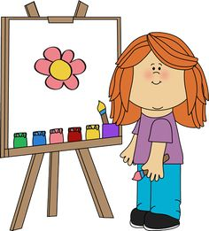
The Art Education is designed to give children the experience and skills to create and observe various visual forms, to cultivate a positive attitude to artistic expression and raise awareness on issues related to Environment, Art and Culture.

Slide 16

Ολόπλευρη ανάπτυξη
Γνωστικά αντικείμενα
Full development
Cognitive lessons
Μουσική
Αγωγή
Music
Education

Slide 17
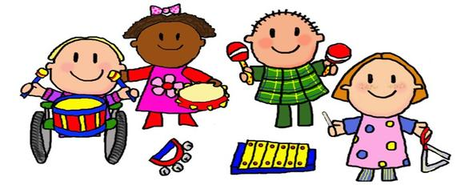
PURPOSES
To enjoy music.
To learn to sing properly.
To understand the basic concepts of music. (slow-fast, loud-soft)
To know the different musical instruments.

Slide 18

Ολόπλευρη ανάπτυξη
Γνωστικά αντικείμενα
Full development
Cognitive lessons
Φυσική αγωγή
Physical
Training

Slide 19
PURPOSES
To understand the importance of exercise in our lives.
To develop basic motor skills and ability to coordinate movements.
To develop endurance, flexibility, agility.
To use movement to express themselves freely and creatively using music, rhythm, dance, drama.

Slide 20
Ολόπλευρη ανάπτυξη
Γνωστικά αντικείμενα
Αγωγή
Υγείας
Health
Education
Full development
Cognitive lessons

Slide 21
Myself
The organs and functions of the body,
Senses Sensors,
The two sexes

Slide 22
My self and others
Personal development
Self-awareness
Socially acceptable behavior interpersonal relationships
Family, relatives, friends, social events.

Slide 23
Nutrition and health
Origin and nutritional value of foods.
Use and abuse of substances,
I protect my health,
Healthy living habits

Slide 24
Socialization
Development of skills of good work and cooperation
Growing environmental awareness

Slide 25
Acceptance of diversity of people
Resolution of disputes and conflict with dialogue.

Slide 26
Respect feelings and rights of other children.
Respect people different color, language and race

Slide 27

Ολόπλευρη ανάπτυξη
Γνωστικά αντικείμενα
Full development
Cognitive objects
ΚΟΙΝΩΝΙΚΕΣ
ΣΠΟΥΔΕΣ
Social Studies

Slide 28

Improvement of social skills
Verbal communication
Active listening
Conflict Resolution
Cooperation, taking decision
Empathy
Acceptance, Friendship.
Relationships

Slide 29
All children to acquire,
Communication skills in order to adapt and integrate them in the school. (Child Socialization, personality traits. Personal Security. Emotional stability)

Slide 30

Ολόπλευρη ανάπτυξη
Γνωστικά αντικείμενα
Full development
Cognitive lessons
Ιστορία
History

Slide 31

Goals
Familiarity in the use of concepts of time (before, after, later, today)
Place events in time in a variety of ways of periods (one day, one week, one month)
Comparison of fixed and changed data
The age as a data that differentiate in time, objects and persons

Slide 32
Ολόπλευρη ανάπτυξη
Γνωστικά αντικείμενα
Full development
Cognitive lessons
Γεωγραφία
Geography

Slide 33

Goals
Use of space-time concepts (in, out, up, down, in front, back, between)
Evaluation of the use of the place of the kindergarten
Use of weather concepts with appropriate vocabulary
Connection of the weather with human activities
Improvement of the skills geographical investigator with outdoor study

Slide 34
Ολόπλευρη ανάπτυξη
Γνωστικά αντικείμενα
Full development
Cognitive lessons
Θρησκευτική
Ηθική αγωγή
Religious and Moral Education

Slide 35
PURPOSES
To realize their religious identity and how it is connected to their daily life, tradition and history of the country
To get in touch with the religious cultural practices of the country and the tradition
To appreciate and cultivate the Christian values of love, peace, friendship, coexistence, equality, respect for diversity in a way that motivates altruistic action

Slide 36
Ολόπλευρη ανάπτυξη
Γνωστικά αντικείμενα
Full development
Cognitive lessons
Τεχνολογία
Technology

Slide 37

PURPOSES
To know the different parts of the computer and its use.
To acquire basic computer skills.
To know and use modern learning technologies.
To realize the importance of using a computer and potential drawbacks.

