Slide 1

Nipiagogeio
Potamou Germasogeias 1
KINDERGARTEN TIMETABLE
School year 2020-2021

Slide 2


Free and structured game
7.45-9.05
LEARNING CENTERS
Visual & Creative Activities
Growing skills in imagination, creativity, knowledge and refresher course.
Paint, plastic, adhesive-collage, stamps, Finger-paints
Activities that emerge
literacy and mathematics
Pre-writing skills, pre-reading
and pre-math skills

Slide 3

Free and structured game
7.45-9.05
Developing of social skills
Collaboration, communication, mutual acceptance, decision making, friendship. Role play, experiments, observations, game with pedagogical material.
Activity in permanent interest fields-learning centres. Computer, Library, Nature corner, Music corner, Grocery store, Dollhouse, Puppet, Building material, Sandpit, Waterpit.

Slide 4


STUDIES-LESSON
STUCTURED ACTIVITY
9.05-9.45
Language, Science, Mathematics, Environmental Education, Health Education, Geography, History
Technology, Ethics / Religious Education Social Action

Slide 5

Washing - Lunch 9.45-10.05
HEALTHY RULES-HEALTHY NUTRITION
OUTDOOR GAMES
Break 10.05-10.45

Slide 6


STUCTURED ACTIVITY
Fairy tales/Puppet Theatre
10.45-11.25
11.25-11.50
Music / Dance / Gymnastics/
Theatrical play-Movement

Slide 7
11.50-12.05
Fruit/Vegetable time
12.05-12.25
OUTDOOR GAMES Small break
12.25-13.05
Free and structured game
Game with pedagogical material
Language (Emerging Literacy Skills), Mathematics and evaluation for individuals or groups

Slide 8
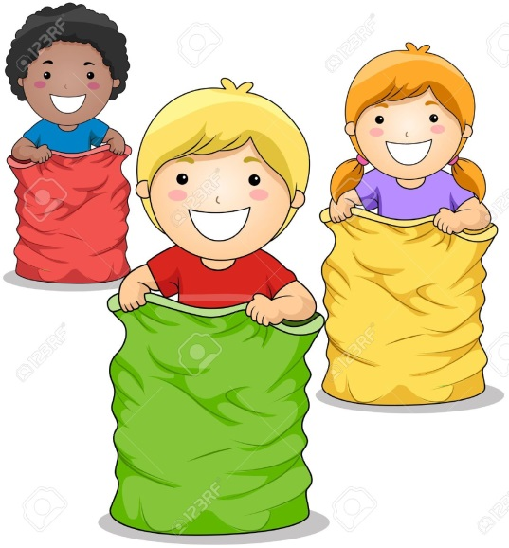
FLEXIBLE SCHEDULE

